Slide 1


Slide 2
F.E.A.R Corporation Financial Results H1 2017
Unaudited annual financial results for half year ending 14 May 2017. The report contains the Director’s views, the Corporation’s consolidated financial statements and maps a way forward in the second half of 2017 financial year.

Slide 3
Contents
Directors’ Report
Directors’ details
Principal activities
Review of operations and financial results
Events arising since the end of the reporting period
Likely developments, business strategies and prospects
Material business risks faced by the Corporation
Consolidated Profit & Loss Account for half year ended 14 May 2017
Consolidated Statement of Financial Position as at 14 May 2017
Capital management policies and procedures
Directors’ Declaration

Slide 5
Principal activities
During the half year, the principal activities of entities within the Corporation were:
sale, customisation and integration of IT and telecommunications systems
maintenance of IT and telecommunications systems
internet based selling of books, hardware and software products
music recording and publishing
design and manufacture of steel-based farming equipment; and
social media marketing services.

Slide 7
Consolidated Profit & Loss Account for half year ended 14 May 2017

Slide 8
Consolidated Statement of Financial Position as at 14 May 2017

Slide 9
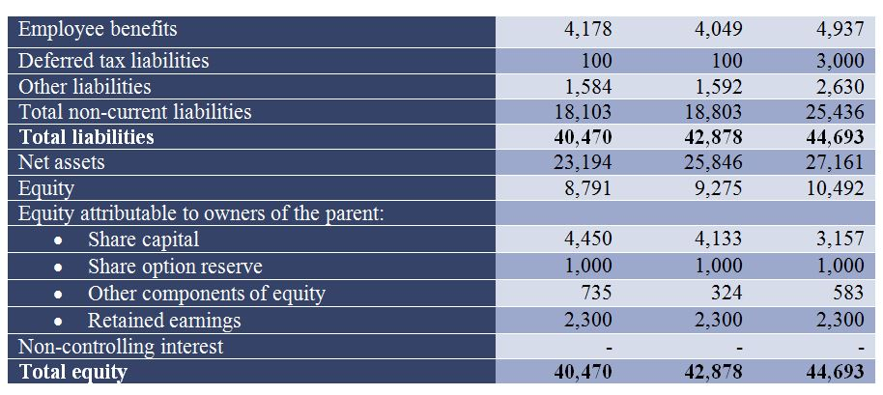
Consolidated Statement of Financial Position as at 14 May 2017

